Slide 1

Git Workshop
Jaime Pizarroso Gonzalo

Slide 2
Version Control System (VCS)
Software tools that helps in recording changes made to files by keeping a track of modifications.
Main advantages:
Helps in recovery in case of any disaster or contingent situation,
Informs us about Who, What, When, Why changes have been made.

Slide 3
VCS classification
Local VCS
Keeps patch sets (differences between files) in a special format on disk.
By adding up all the patches it can then re-create what any file looked like at any point in time.

Slide 4
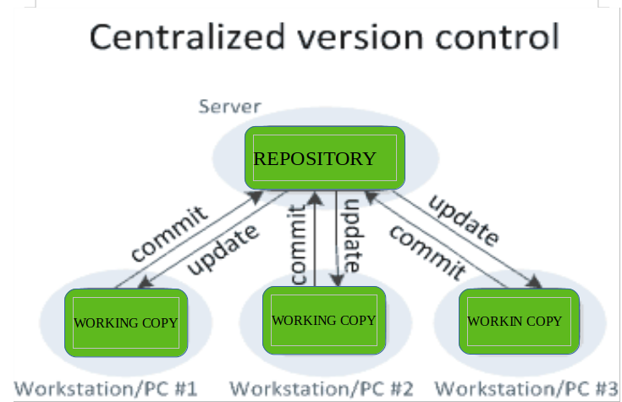
VCS classification
Centralized VCS
Contain just one repository globally.
Every user need to commit for reflecting one’s changes.

Slide 5
VCS classification
Centralized VCS
Fine-grained control over who can do what.
Single point of failure (server)

Slide 6
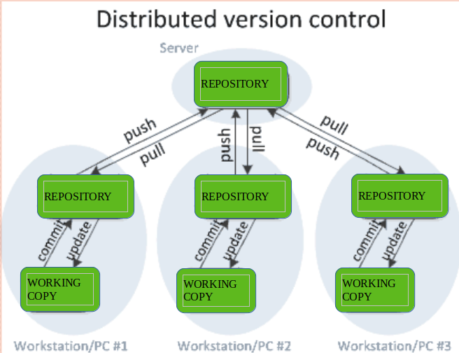
VCS classification
Distributed VCS
Contain multiple repositories.
Every user need to commit for reflecting one’s changes in local repository.
Push is needed to reflect changes in remote repository.

Slide 7
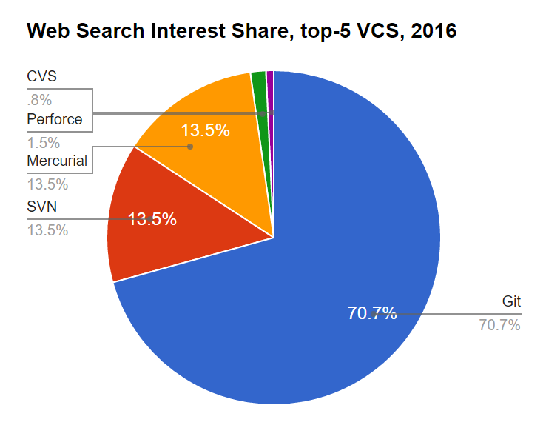
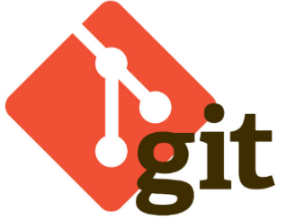




What is Git?
Most popular VCS in the world.

Slide 8

A brief history of git
Created by Linus Torvalds in 2005
Designed to do version control on Linux kernel.
Goals of git
Speed
Support for non-linear development
Fully distributed
Able to handle large projects efficiently

Slide 9
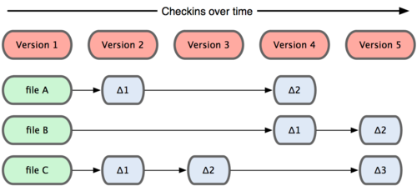
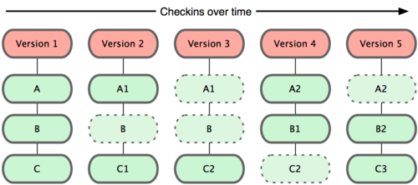
Git snapshots
Subversion
Centralized VCS track version data on each individual file
Git keeps “snapshots” (commits) of the entire state of the project.
Git

Slide 10
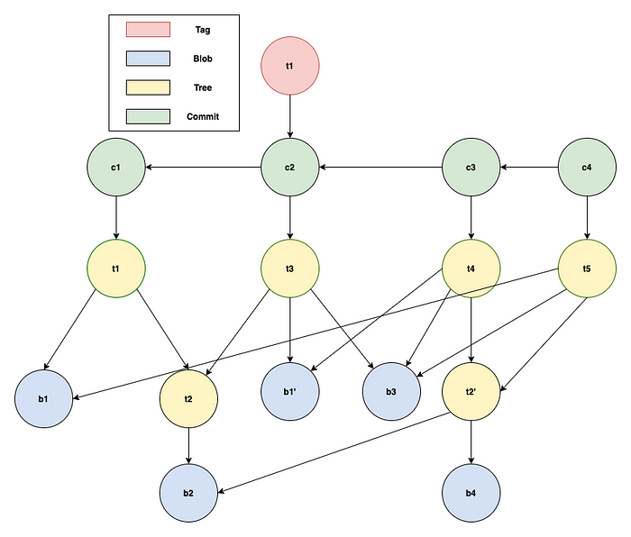
Directed-Acyclic-Graph (DAG)
1. In commit C1; 2 files b1 and b2 are committed with b2 in t2 directory.
2. In commit C2; b1 is changed to b1' and new file b3 is added.
3. In commit C3; a new file b4 is added in t2 directory which changed tree corresponding to t2 directory to t2'.
4. In commit C4 file b1' is changed back to earlier implementation i.e. b1.

Slide 11
Simple Git model
my-project
docs
manual.docx
user_docs.docx
src
main.rkt
module1.rkt
Here are your files, sitting in a directory called my-project

Slide 12
Simple Git model
my-project
docs
manual.docx
user_docs.docx
src
main.rkt
module1.rkt
.git
When you have a git repository, you have an additional directory called .git, which points at a mini-filesystem.
This file system keeps all your data, plus the bells and whistles that git needs to do its job.

Slide 13
Simple Git model
my-project
docs
manual.docx
user_docs.docx
src
main.rkt
module1.rkt
.git
This mini-filesystem is highly optimized and very complicated. Don’t try to read it directly.
The job of the git client is to manage this for you.

Slide 14
Simple Git model
You edit your local files directly.
You can edit, add files, delete files, etc., using whatever tools you like.
This doesn’t change the mini-filesystem, so now your mini-fs is behind.

Slide 15
Simple Git model
my-project
docs
manual.docx
user_docs.docx
src
main.rkt
module1.rkt
.git
Commit
When you do a “commit”, you record all your local changes into the mini-fs.
The mini-fs is “append-only”. Nothing is ever over-written there, so everything you ever commit can be recovered.

Slide 16
Simple Git model
Your local machine
Server (e.g., github.com)
my-project
docs
manual.docx
user_docs.docx
src
main.rkt
module1.rkt
.git
push
At the end of each work session, you need to save your changes on the server. This is called a “push”.
Now all your data is backed up. You can retrieve it, on your machine or some other machine.

Slide 17
Simple Git model
Your local machine
Server (e.g., github.com)
my-project
docs
manual.docx
user_docs.docx
src
main.rkt
module1.rkt
.git
pull / fetch
pull
To retrieve your data from the server, you do a “pull”. A “pull” takes the data from the server and puts it both in your local mini-fs and in your ordinary files.
If your local file has changed, git will merge the changes if possible. If it can’t figure out how to the merge, you will get an error message.
You can also do a “fetch” to retrieve data from server, which we would cover later on.

Slide 18
Simple Git model
Your local machine
Server (e.g., github.com)
my-project
docs
manual.docx
user_docs.docx
src
main.rkt
module1.rkt
.git
push
pull / fetch
Commit
pull

Slide 19
Git stages
Local machine
Remote server
Workspace
Staging
Local repository
Remote/origin repository
Remote
repository
git add/mv/rm
git commit
git push
git commit -a
git fetch
git reset <file>
git reset <commit>
git diff
git diff HEAD
git clone/pull

Slide 20
About commit messages
Tell what is included in the commit (present tense)
Single line summary followed by more complete description
Ticket or bug number helps

Slide 21
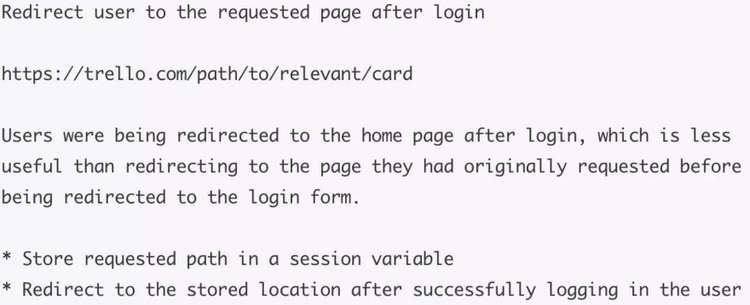
About commit messages
Bad: git commit –m “Fix login bug”
Good: git commit –m “

Slide 22
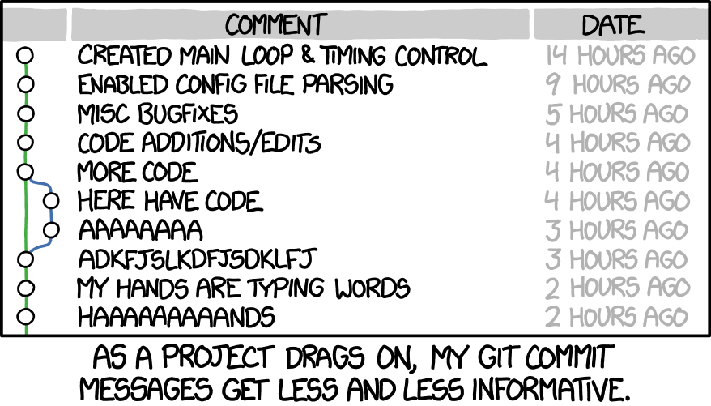
About commit messages

Slide 23
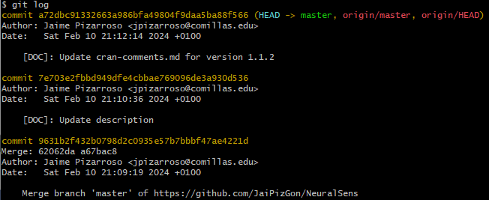
Repo history
To check what has been done in a repo, use git log:

Slide 24
Repo history
To check what has been done in a repo, use git log:
Unique SHA-1 hash (40 character string hex digits) generated by Git for every commit.

Slide 25
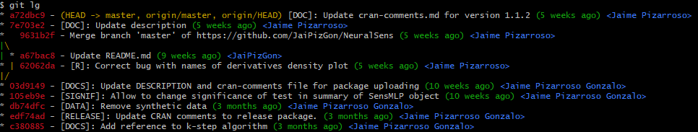
Repo history
Git log is ugly… let’s make it prettier. Copy and paste the following command in a terminal:
git config --global alias.lg "log --color --graph --pretty=format:'%Cred%h%Creset -%C(yellow)%d%Creset %s %Cgreen(%cr) %C(bold blue)<%an>%Creset' --abbrev-commit"

Slide 26
The HEAD pointer
Pointers are used constantly in git.
As new commits are made, the HEAD pointer changes
HEAD always points to the “tip” of the currently checked-out branch in the repo.
HEAD points to the parent of next commit.

Slide 27
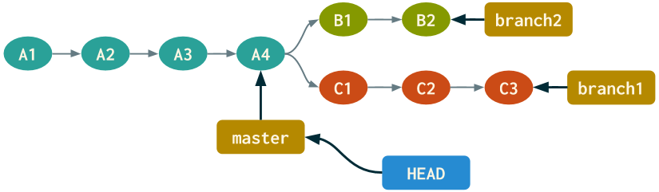
The HEAD pointer
HEAD always points to the “tip” of the currently checked-out branch in the repo.
You can checkout to other commits using its hash ID → detached HEAD

Slide 28
Staging files
Use git add <file> to begin tracking the changes in a <file>.
IMPORTANT: You can use git add . or git add –A to stage all files. Don’t. Trust me. At most, use git add –u to stage all modified files that you have already commited at some point.

Slide 29
.gitignore
The .gitignore file shall be one of the first files that shall be created within the repository.
In this file there shall be all the files/extensions/folders you do not want to keep track of. Here is a good tutorial.

Slide 30
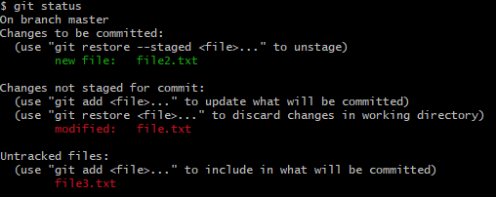
Repo status
Use git status to check your staged, unstaged and untracked files, in that order.

Slide 31
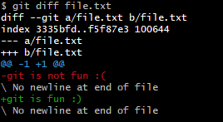
Checking changes
Use git diff <file> to check the differences between the workspace and the HEAD commit.
Use git diff --staged <file> to compare staged vs HEAD
Use git diff to compare all changes in workspace files vs HEAD

Slide 32
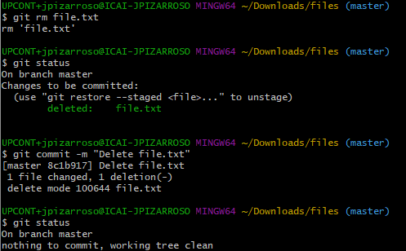
Removing files
Removing files are changes in the repository, so you have to commit them. You can use git rm <file> to delete files.

Slide 33
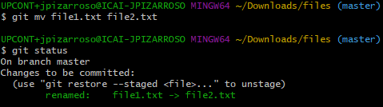
Renaming files
Moving (or renaming) a file is also a change in the repository, so you have to commit it. You can use git mv <file1> <file2> to rename <file1> to <file2>.

Slide 34
Undo changes (working space)
In case you want to undo changes made in the working space, use git checkout <file> or git checkout <branch>.
Git checkout retrieves files from local repository.

Slide 35
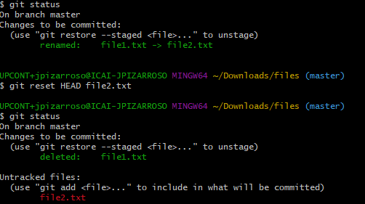
Undo changes (staging area)
In case you want to undo changes added to the staging area, use git reset HEAD <file>:

Slide 36
Undo changes (local repo)
In case you want to revert to a previous commit, you can use:
git reset --hard HEAD~1 or git reset --hard HEAD^
This moves the HEAD pointer and branch to previous commit.
Careful if changes in local repo have been pushed to remote server.

Slide 37
Modify last commit
To modify the last commit: git commit --amend –m “message”
Allows to amend a change to the last commit
Anything in staging area will be amended to the last commit.
Careful if last commit has been already pushed to remote server.

Slide 38
Branching
It means you diverge from the main line of development and continue to do work without messing with that main line.
Unlike many other VCSs, Git encourages workflows that branch and merge often, even multiple times in a day.
A branch in Git is simply a lightweight movable pointer to one of these commits.
A good gamified tutorial.

Slide 39
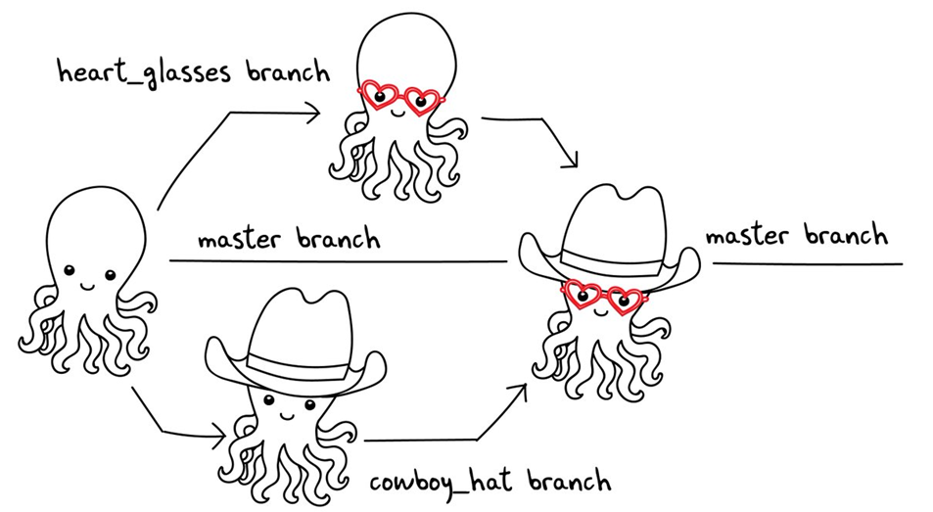
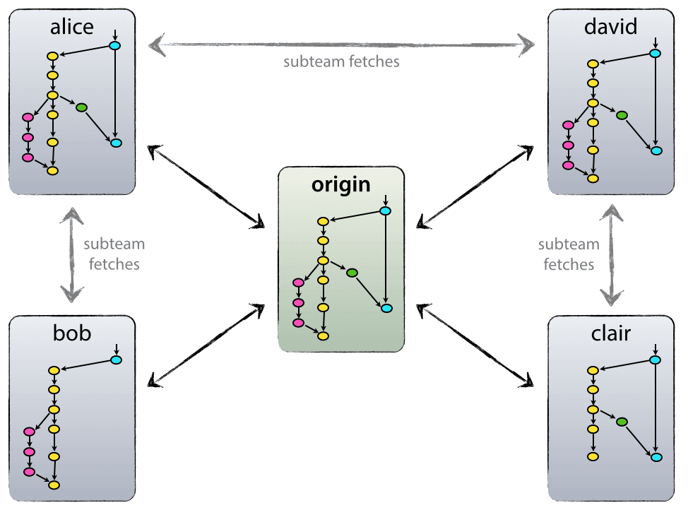
Branching power

Slide 40

Branching power
Too much power → Git workflow design → Git flow

Slide 41
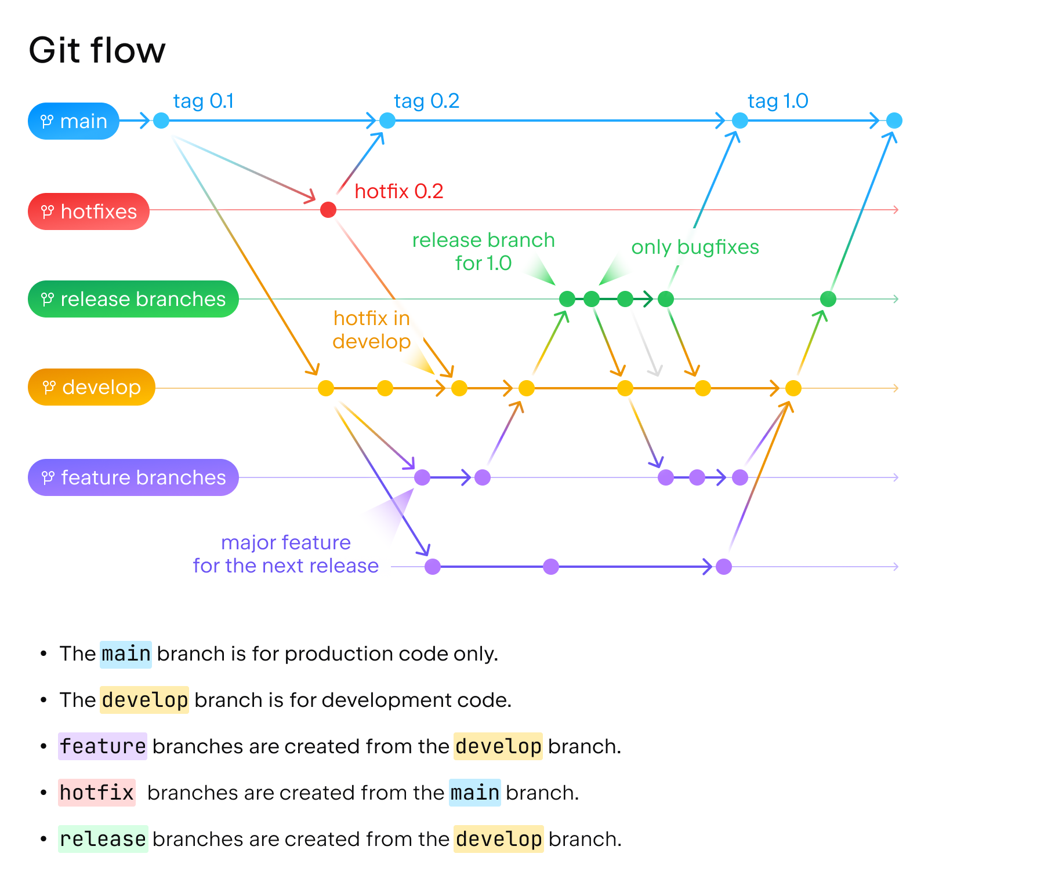
Git flow

Slide 42
Develop and master
Two main branches with infinite lifetime:
master – Contains production code. Stores official release history. Shall be protected from most developers. All commits shall be tagged with a version number.
develop – Contains pre-production code. Serves as an integration branch for features. May be protected from some developers.

Slide 43
Supporting branches
Branches to aid parallel development and prepare production releases. Each has a specific purpose and strict rules of origin and merge.
Feature branches
Release branches
Hotfix branches

Slide 44
Feature branches
Must branch from develop
Must merge to develop
Used to develop new features.
The feature branch exists as long as the feature is in development. Eventually, it must be merged back to develop or discarded.

Slide 45
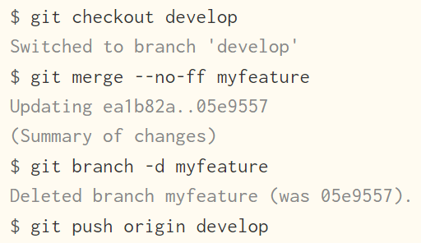

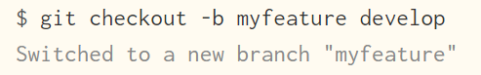
Feature branches

Slide 46
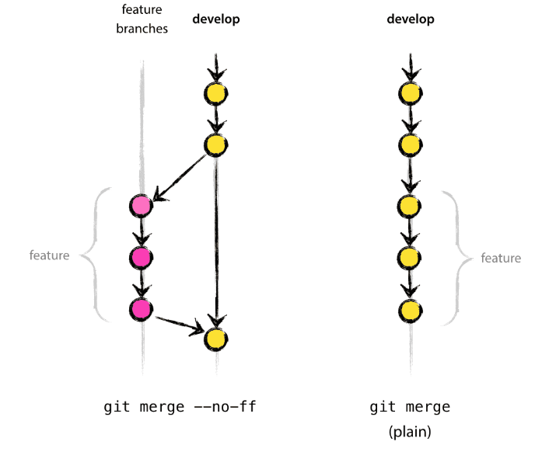
Merge

Slide 47
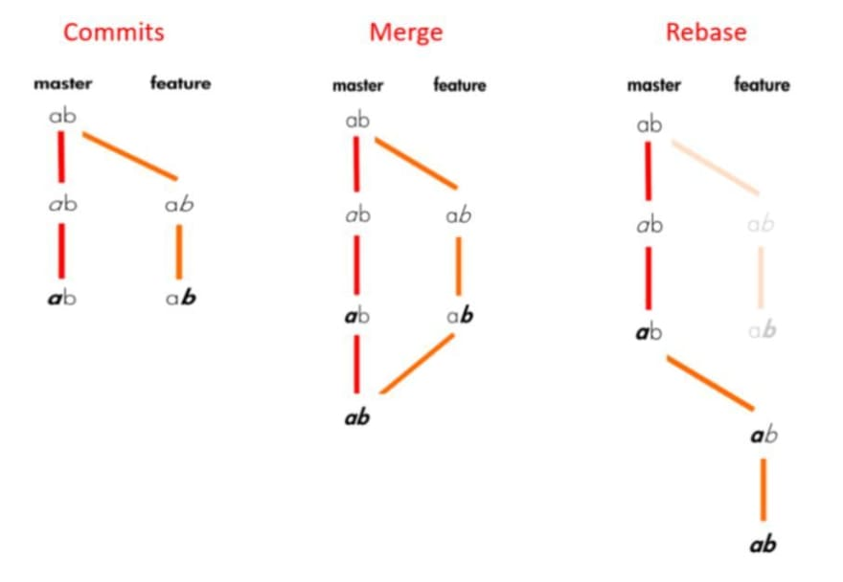
Merge vs Rebase

Slide 48
Release branches
Must branch from develop
Must merge to develop and master
Support preparation of a new production release.
They allow for minor bug fixes and preparing meta-data for a release. Bug fixes shall be merged back to develop.

Slide 49

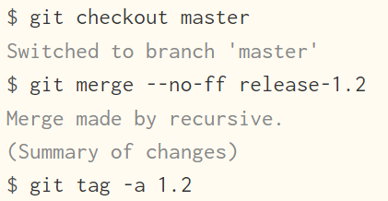

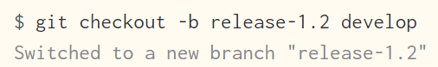
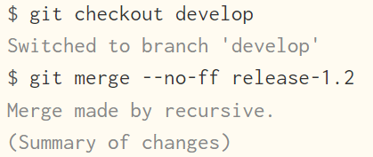
Release branches

Slide 50
Hotfix branches
Must branch from master
Must merge to develop and master
Similar to release branches. Support preparation for an unplanned production release.
Arise from the necessity of solving a bug in the live production version.

Slide 51

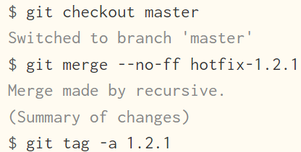
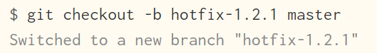
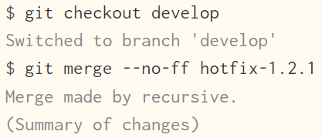
Release branches

Slide 52

Remote git repositories

Slide 53
Github
Github, since 2008, is an online application that provides:
A visual interface for git
Free cloud storage for your projects’ files.

Slide 54
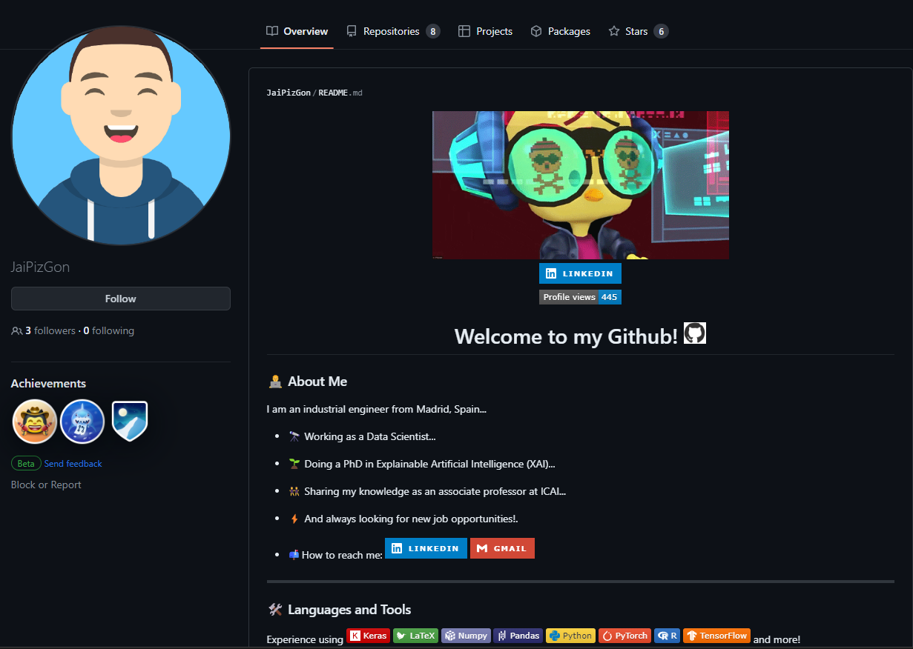
Github profile

Slide 55
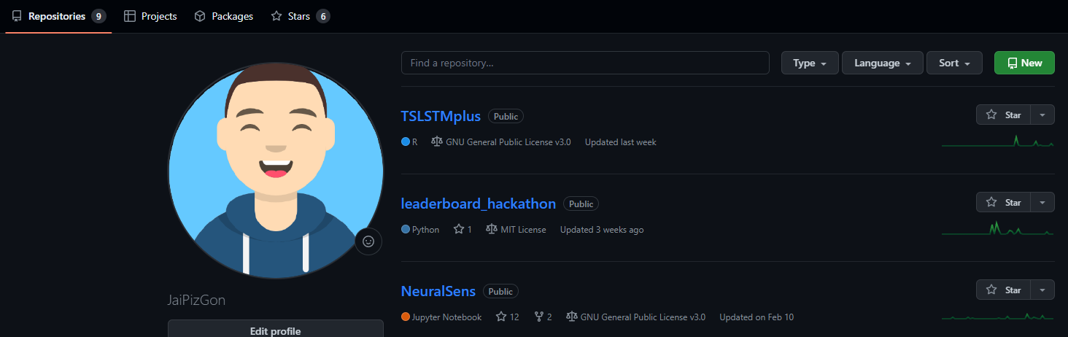
Creating a repository

Slide 56
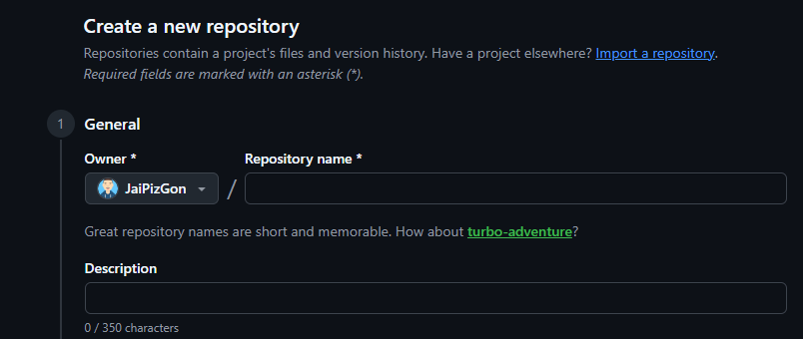
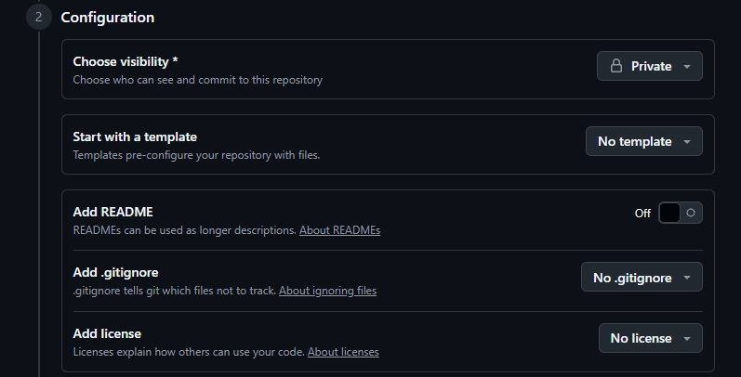
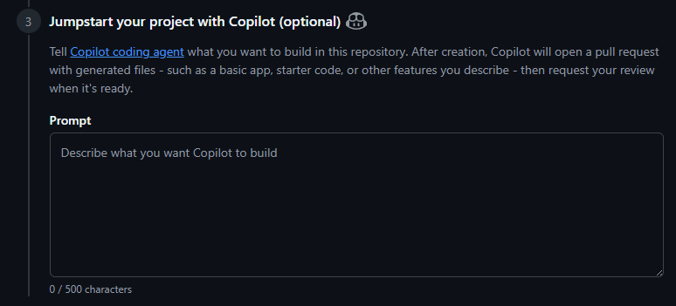
Creating a repository

Slide 57
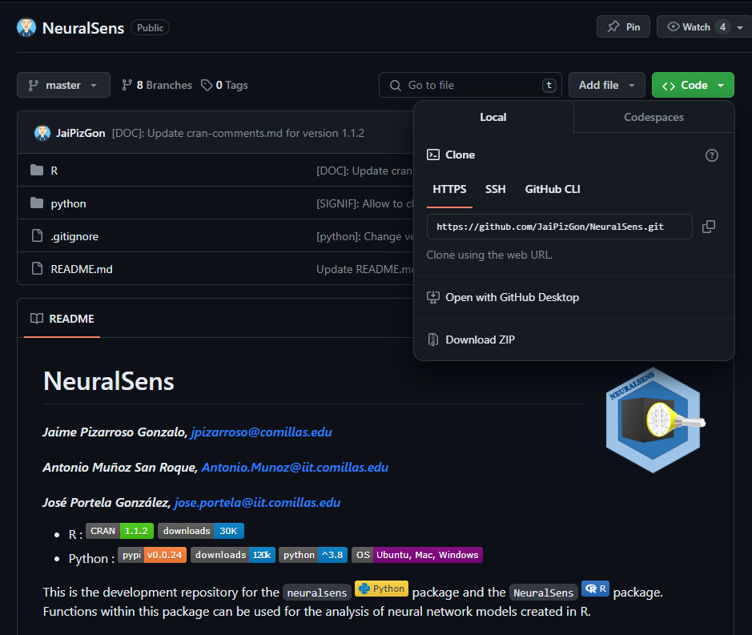
Git clone
git clone https://github.com/JaiPizGon/NeuralSens.git

Slide 58
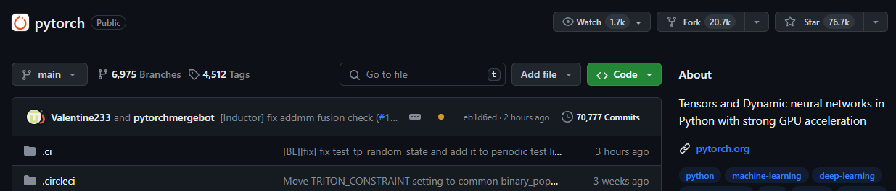
Contributing

Slide 59
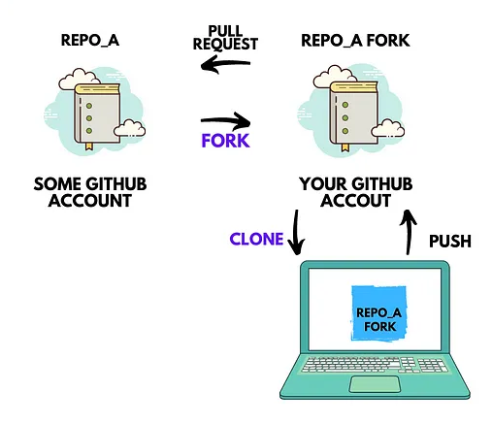
Git fork

Slide 60
Pull request
Once you have an improvement, you may ask for a pull request.
In their simplest form, pull requests are a mechanism for a developer to notify team members that they have completed a feature.
This can be done inside a single project, or from fork to origin.

Slide 61
Github Actions
Github actions automates tasks within software development life cycle.
Github actions are event-driven. For example, run a series of test after a commit has created in develop branch.
Here is a good resource to learn Github Actions.

Slide 62
Thank you for your attention

